Slide 1







Aprus
“Robots in the garden? They work!”
Internet of Things Course Project
Daniele Scala, 4840112
Enrico Pezzano, 4825087
Leonardo Gonfiantini, 4844709

Slide 2
What is Aprus

Slide 3
Objectives
Manage your garden automatically
Check your plants status by a few clicks
Thanks to devices like Arduino or ESP32, nowadays we can interact with sensors and motors to carry out mechanical actions autonomously
There is a need to be able to monitor the samples at any time, and this is possible by interacting with the appropriate service
Organize your sensors and devices
Keep data saved over time
The devices and sensors need to be set up manually, but after preparation, we're done!
A connection (also automatic) with a database is required, because allows us to monitor the progress of my data
Smart response when necessary
Look at results by your dashboard
Following anomalies or problems of any kind, it is necessary to handle triggers as soon as possible
Given the storage of data and the possibility of having dynamic information, we can offer graphs that allow perfect data visualization

Slide 4
How it works
Update the dashboard
The combined use of sensors, scripts and connections via certain modules allows an effective and continuous operational flow
The dynamic graphs are updated, and we can therefore maintain real-time monitoring
Act if necessary
Storage updates in database
If the received data requires taking some action, the device activates the right modules in an autonomous way
We add the data received to the database and then the current state of our garden
Managing your garden automatically is not so impossible, here's how it's done →
Receive data from sensors
Each sensor (we will see them in the next slides) communicates its readings to us every few seconds

Slide 5
The Device

Slide 6
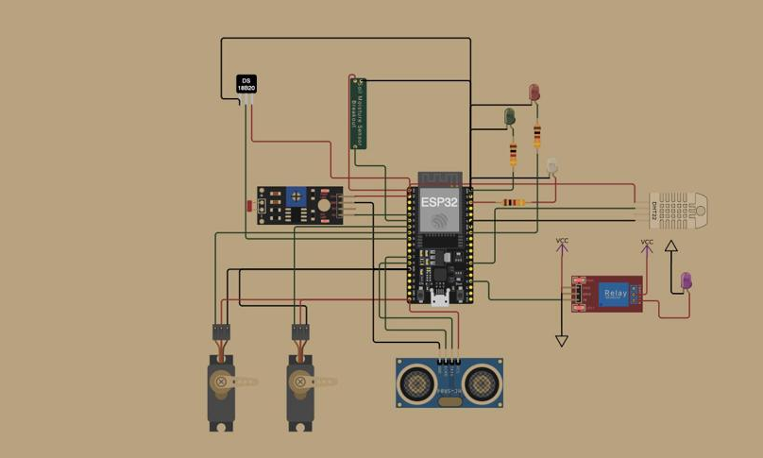
ESP32 v4
Why ESP32
This device has allowed us to connect many different sensors, making it able to manage them all, and above all it is able to perform a WiFi connection and therefore interact via the MQTT protocol
Wokwi environment
Thanks to this environment, we have simulated as best as possible all the behaviors of the different modules and objects connected to the device, therefore able to trigger triggers when necessary and other functions
The processes involved
As mentioned, we have connected to the card various sensors capable of acquiring data, and as many objects capable of responding to these detections to activate consequent mechanisms
If a light sensor communicates a lower lighting level than the desired threshold, it turns ON the specific LED
An example →

Slide 7
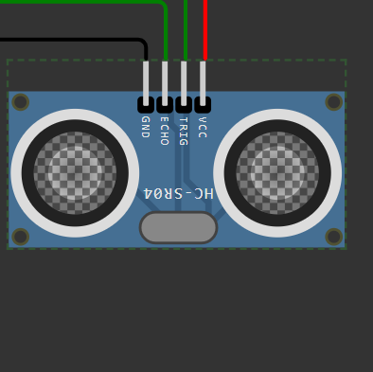
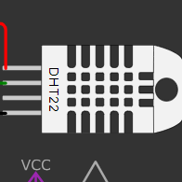
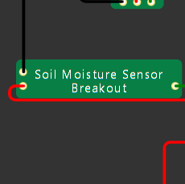


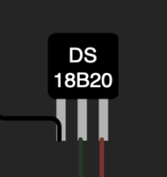
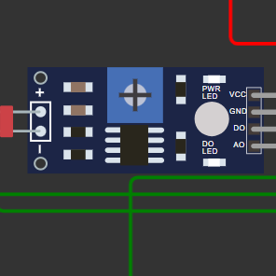
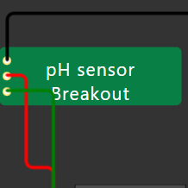
The sensors
Water tank level
External temperature / humidity
Moisture
Thanks to ultrasound, we can measure the water level
This device sends signals about the temperature and humidity it perceives
Custom sensor capable of communicating moisture to us
Soil temperature
Light
A very small, waterproof device that measures soil conditions
photoresistor that turns on or off based on the amount of light it perceives
Manually created probe capable of communicating the pH of the soil

Slide 8
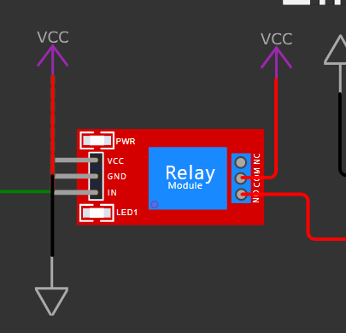
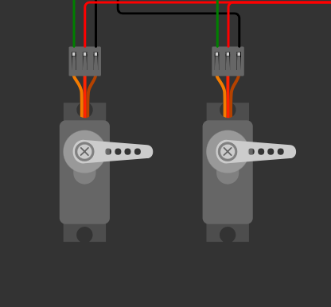
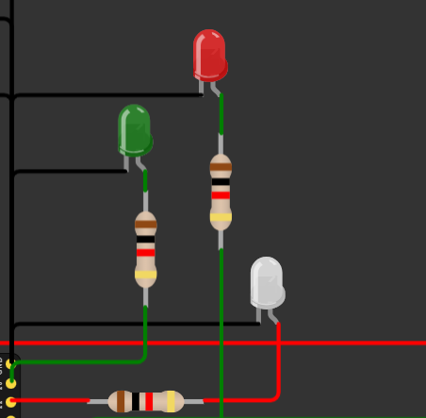
Actuators
Relay
The relay is a device that allows us to turn motors or other mechanisms ON and OFF, based on certain triggers. In our case it was used to manage the turning ON of the water pump
Servos
They are devices equipped with levers which, when operated, can rotate and therefore allow objects to be opened or closed. In our case they serve to pull the sun roof up or down
Lights
The lights, in our case LEDs, have multiple uses. In general, they can be used as actual lighting devices or for simple monitoring. In our case the white LED turns on when little light is detected, while the other 2 serve as monitoring to check the presence of connection

Slide 9
Connection and Data Visualization

Slide 10

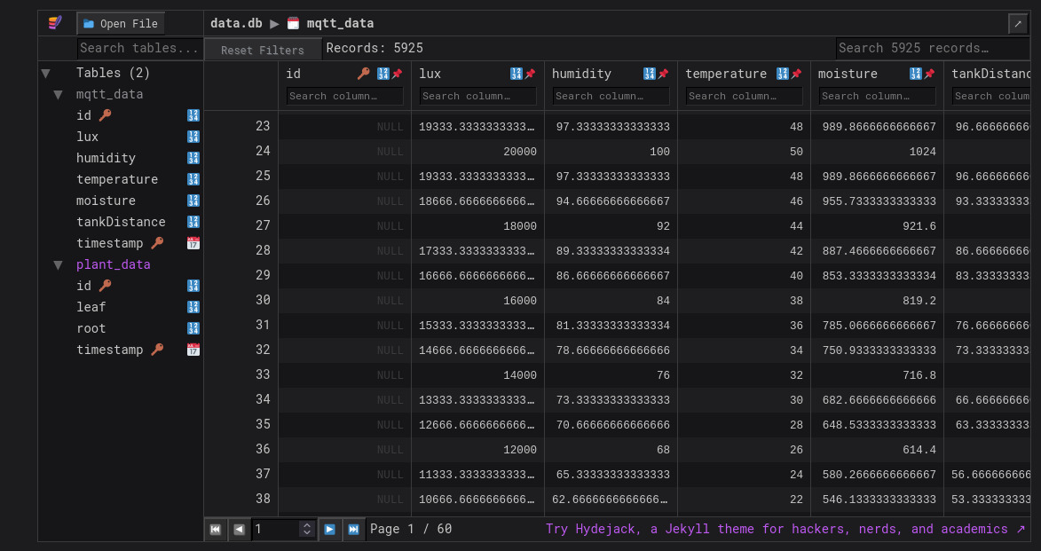
SQLite
What is SQLlite?
SQLite is an in-process library that implements a self-contained, serverless, zero-configuration, transactional SQL
database engine.
The code for SQLite is in the public domain and is thus free for use for any purpose, commercial or private
Why did we choose this kind of system?
Simple logic to handle
Fast connection in every moment
Directly accessible
Perfectly integrated with NodeRed
Free and open source
For larger projects, however, relying on more solid services, such as PostgreSQL, could be more effective

Slide 11
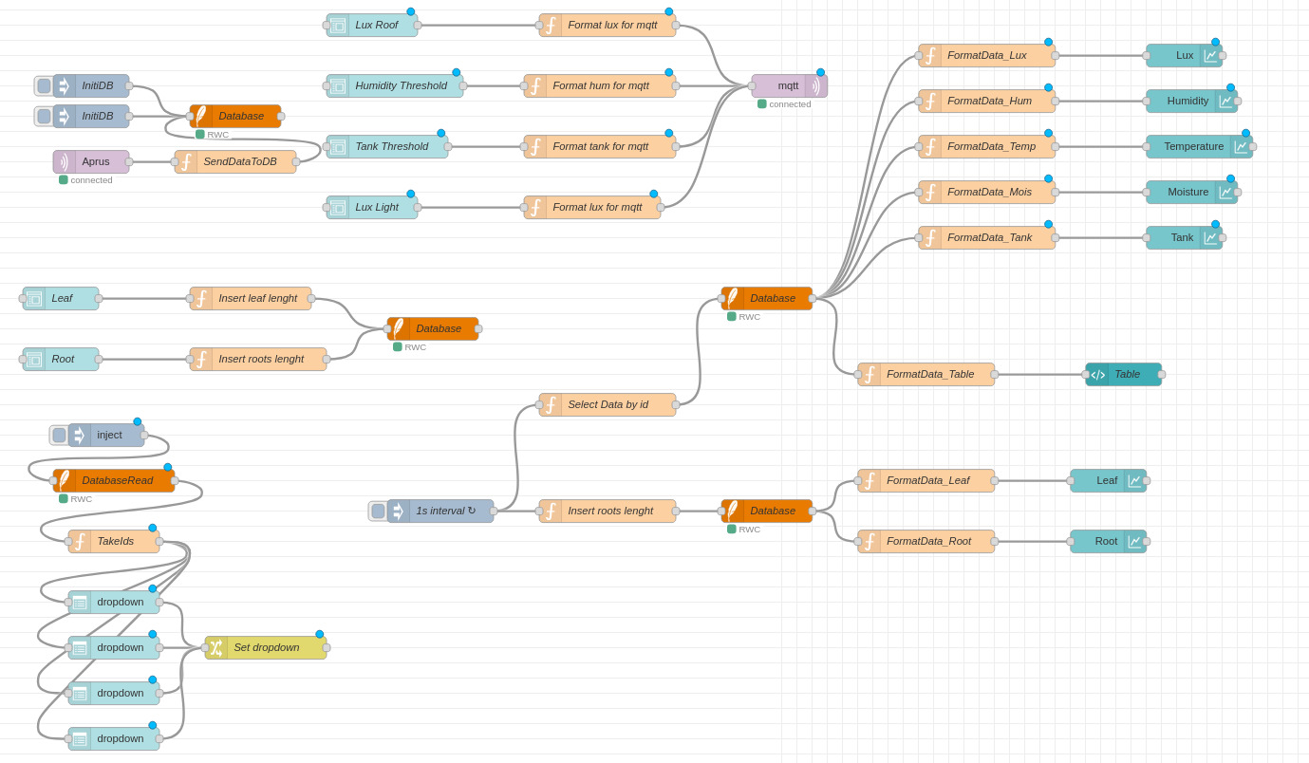
NodeRed
The “brain” of the project
NodeRed allowed us to make the different tools used “communicate”, managing the sensors input and the updating of the Database and Dashboard
Links with other tools
Thanks to the MQTT protocol, we are able to receive all the signals from the device, and through function parsing we can connect with other services
The integrated dashboard
Nodered allowed us to create and manage an internal dashboard for the dynamic visualization of the data received, in the most appropriate way

Slide 12
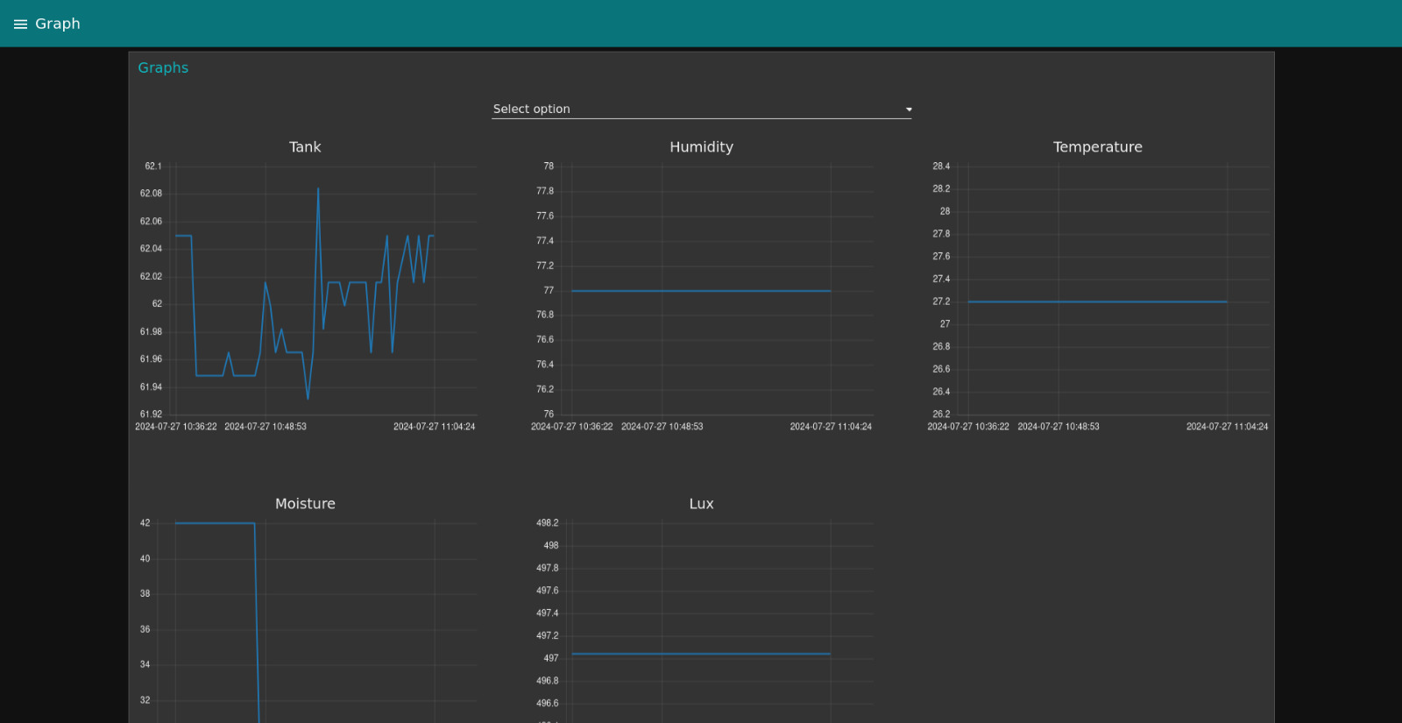
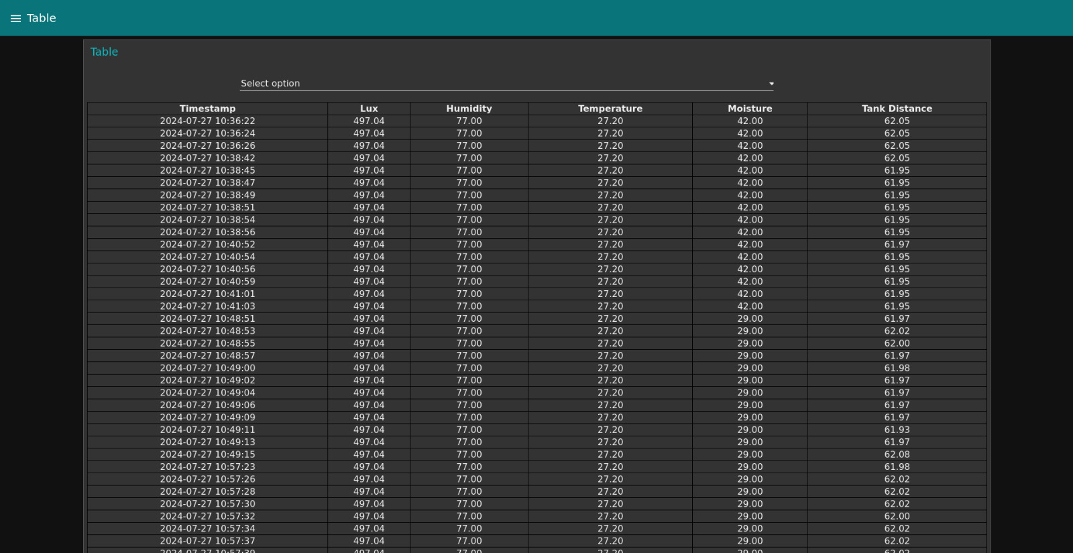
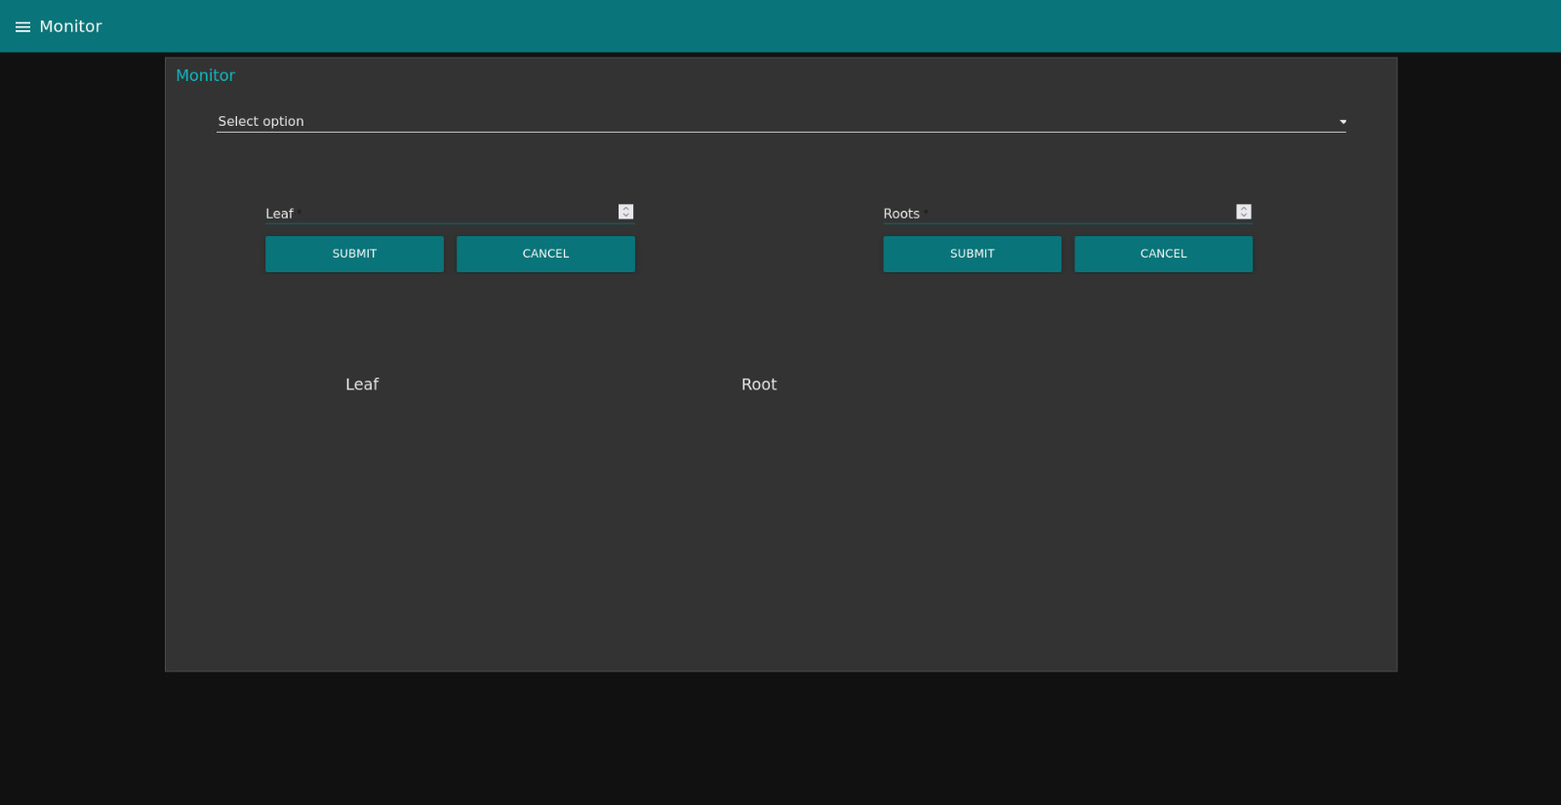
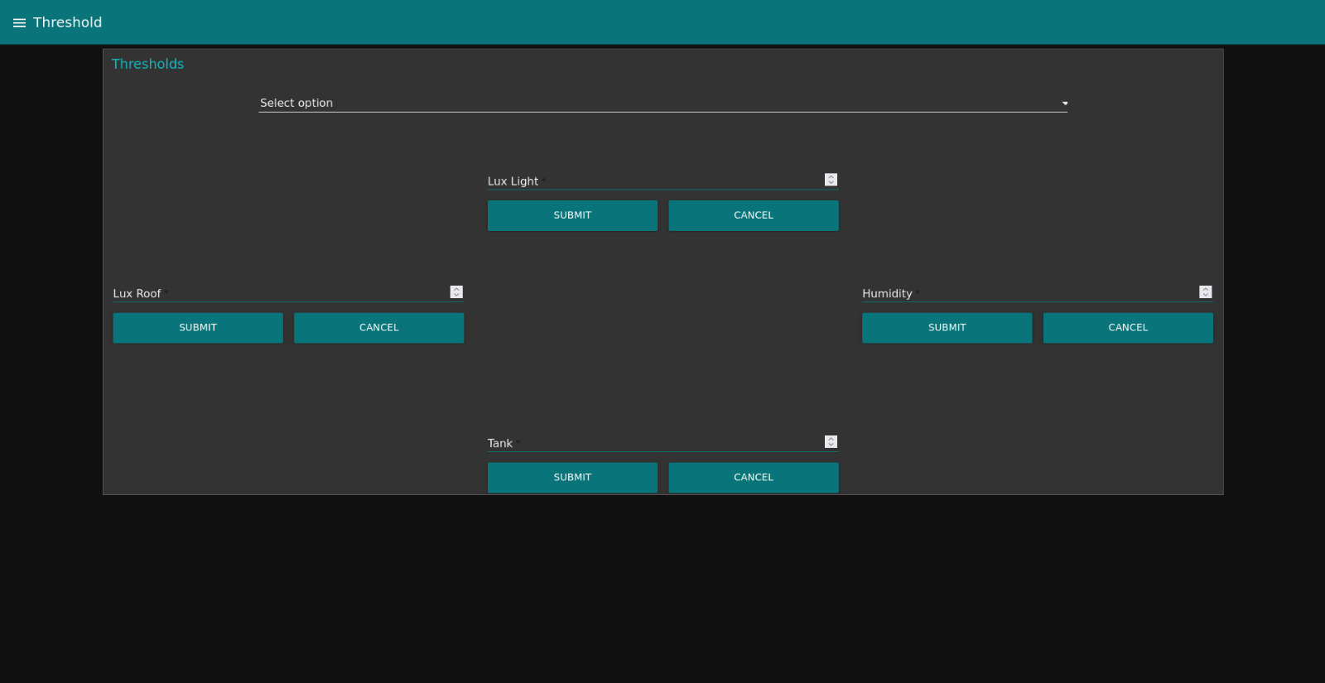
Dashboard

Slide 13
THANK YOU
Questions about our garden? Ask to robots!

